Slide 1
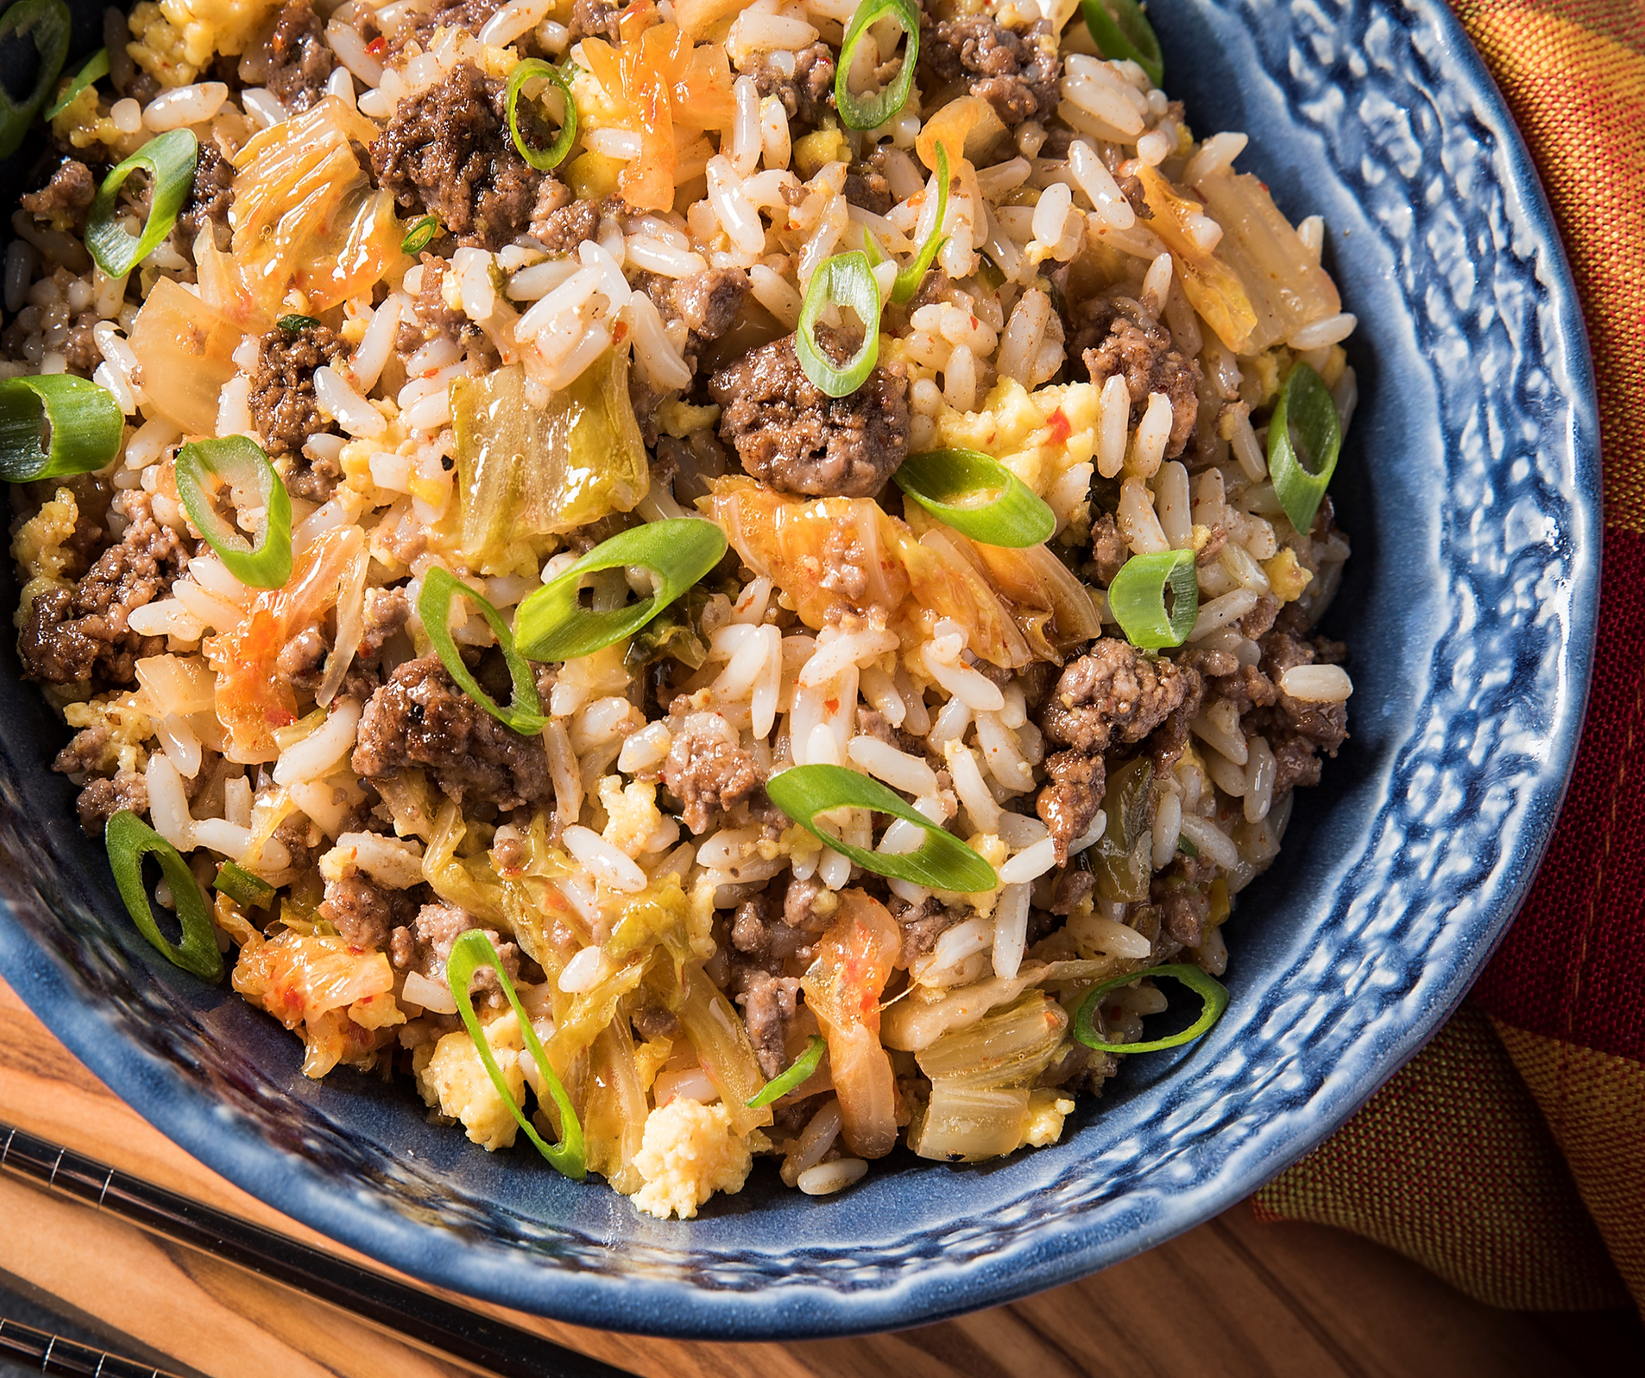
BEEF AND KIMCHI
FRIED RICE BOWL
Be a hero to your guests by bringing them a dish that they can feel good about. Serve them the best of both worlds with this protein-packed bowl, complete with a kick of heat.
To try this recipe, go to:
https://www.certifiedangusbeef.com/recipes/recipedetail.aspx?id=793

Slide 2
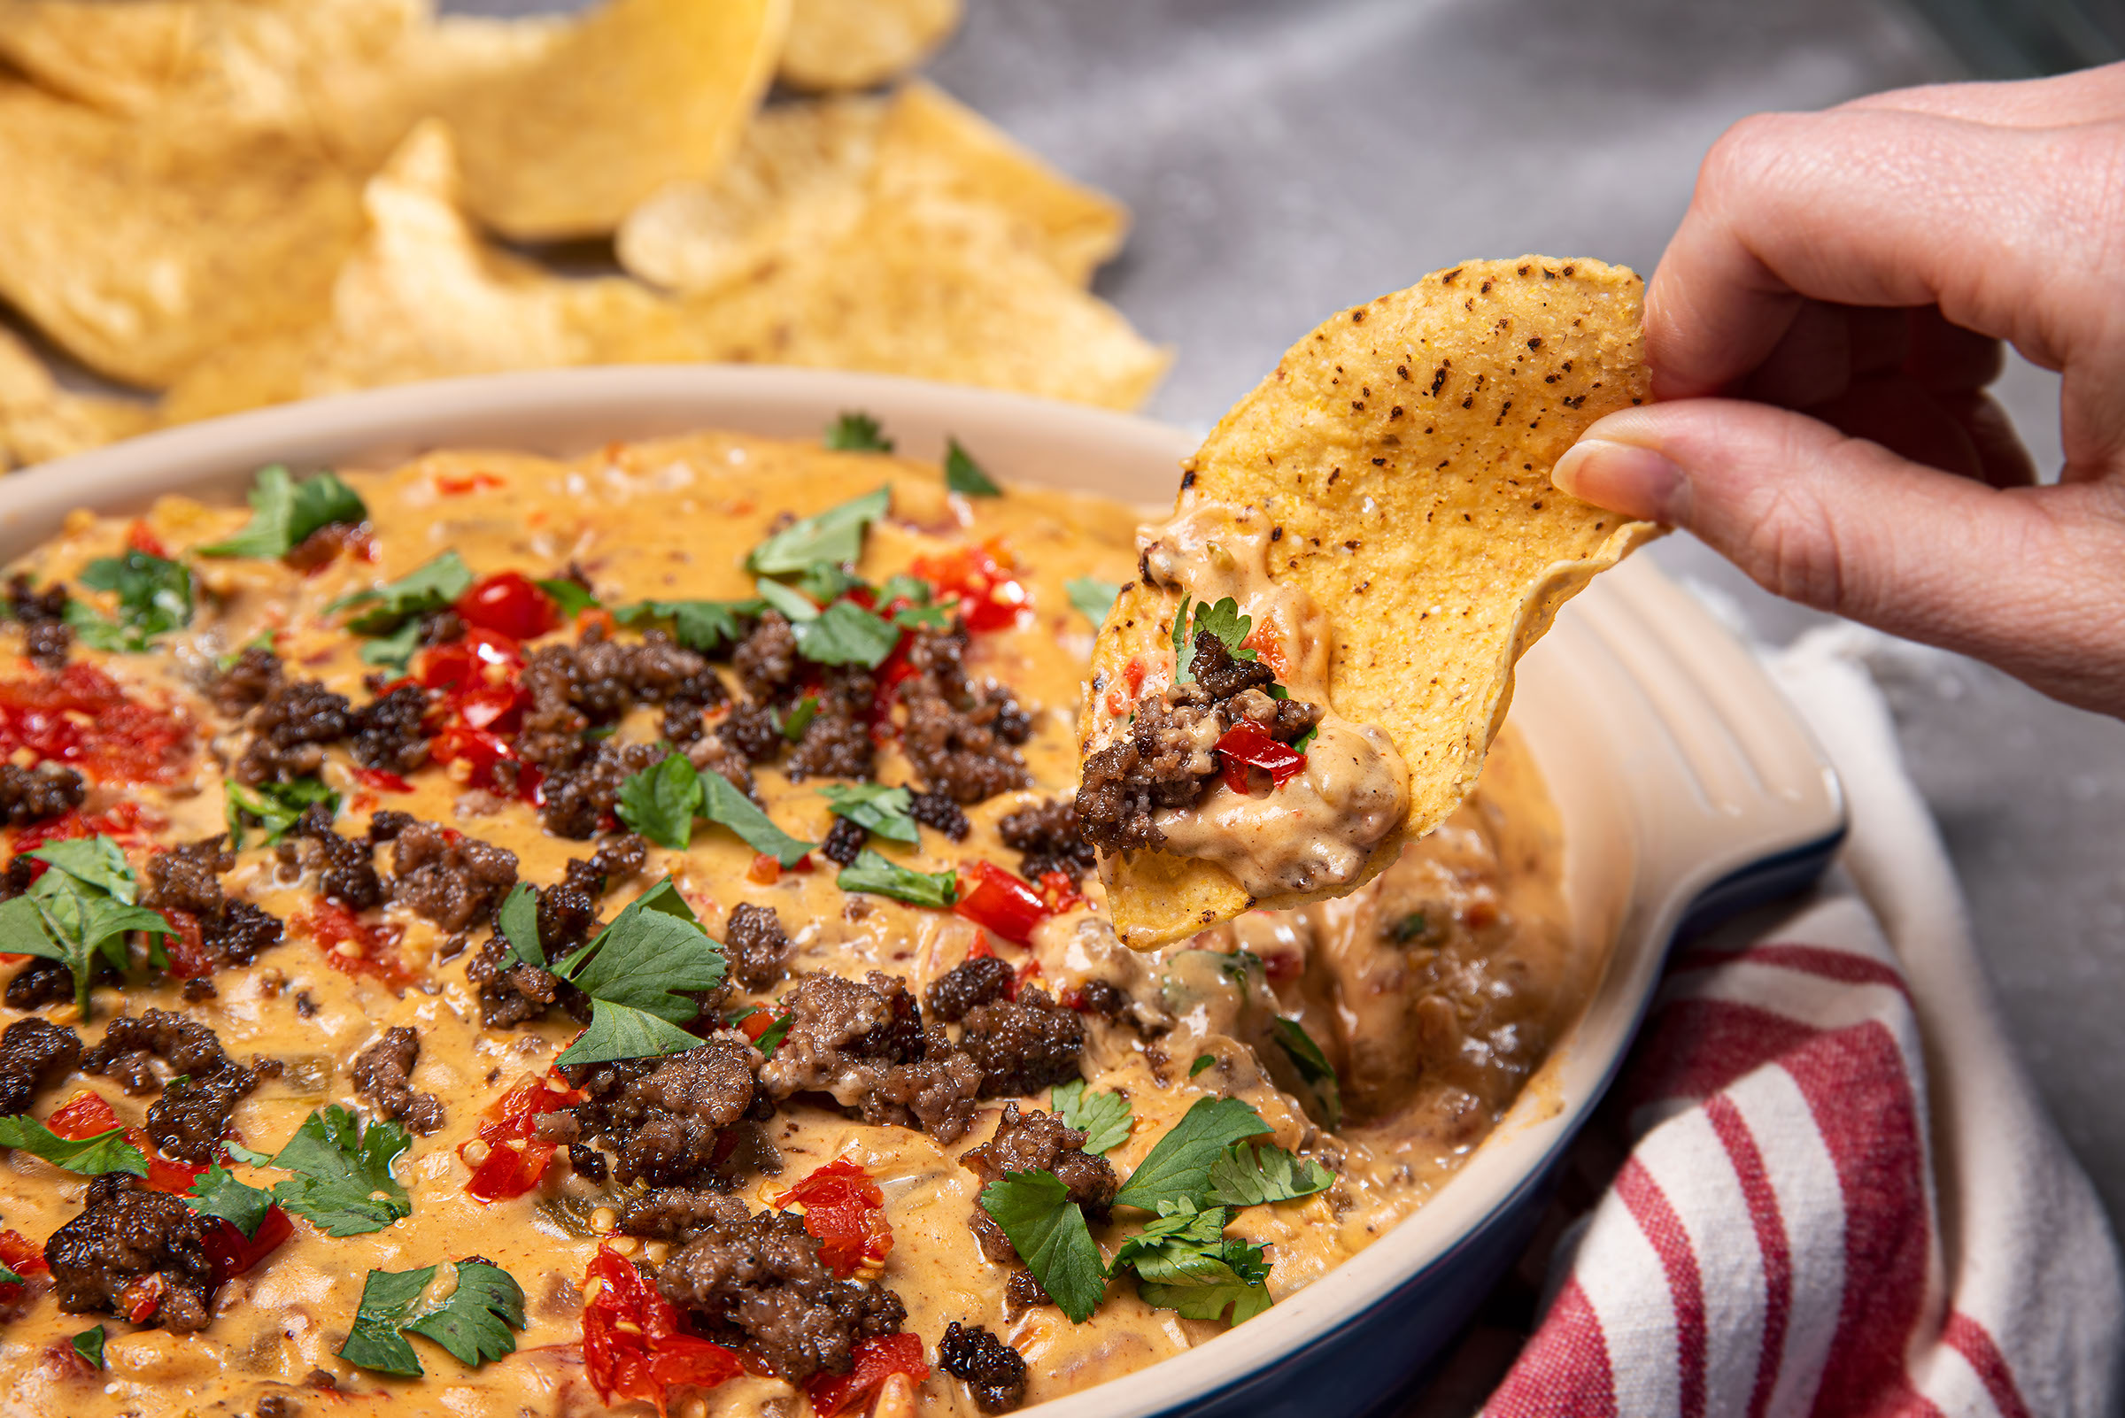
LOADED BEEF QUESO NACHOS
Guilty pleasures are often necessary. Your guests will drool over this cheesy, beefy, crispy goodness.
To try this recipe, go to:
https://www.certifiedangusbeef.com/recipes/recipedetail.aspx?id=923

Slide 3
LEBANESE-STYLE SPICY
BEEF KOFTA KABOBS
The best part of traveling around the world? The food! Bring a taste of Lebanon to your menu with these kabobs for a Mediterranean meal option guests will devour.
To try this recipe, go to:
https://www.certifiedangusbeef.com/recipes/recipedetail.aspx?id=667

Slide 4
PAD THAI SPAGHETTI
SQUASH PROTEIN BOWL
Help guests satisfy their Pad Thai cravings with this lower-calorie spin on the classic dish. Featuring spaghetti squash instead of the traditional rice noodles, it’s a great way to incorporate fresh vegetables without sacrificing flavor or texture.
To try this recipe, go to:
https://www.certifiedangusbeef.com/recipes/recipedetail.aspx?id=875

Slide 5
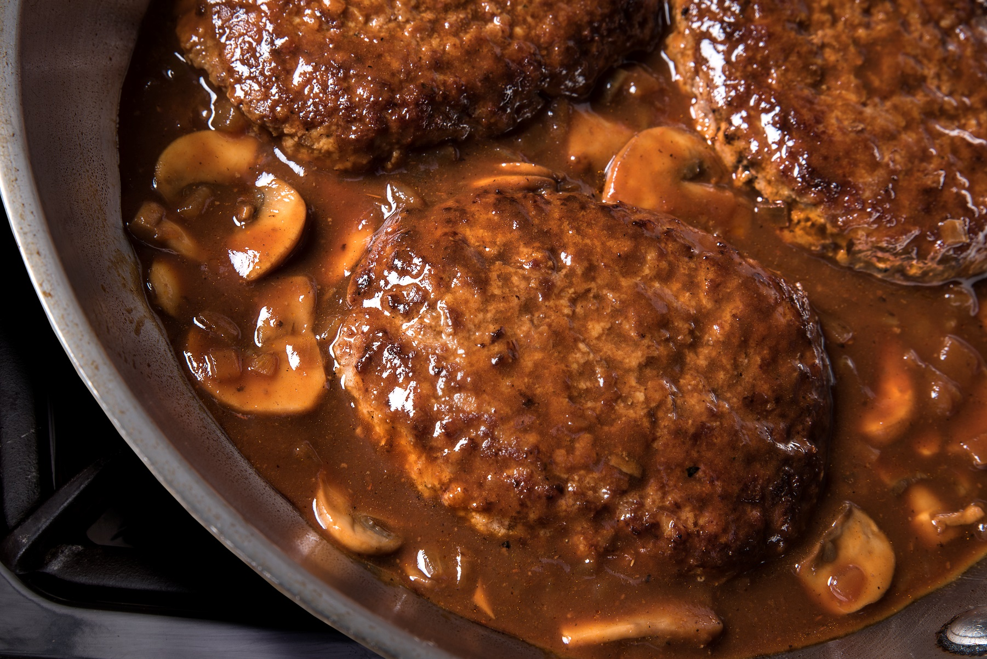
OLD SCHOOL SALISBURY STEAK
Nostalgic dishes often bring big smiles to our faces. This American classic is easy and cost efficient to make — a win for you and your guests.
To try this recipe, go to:
https://www.certifiedangusbeef.com/recipes/recipedetail.aspx?id=786

