Slide 1
LIVE WITH THE BRAND:
Versatile & Flavorful – Sirloin Flap, Flank & Skirts

Slide 2
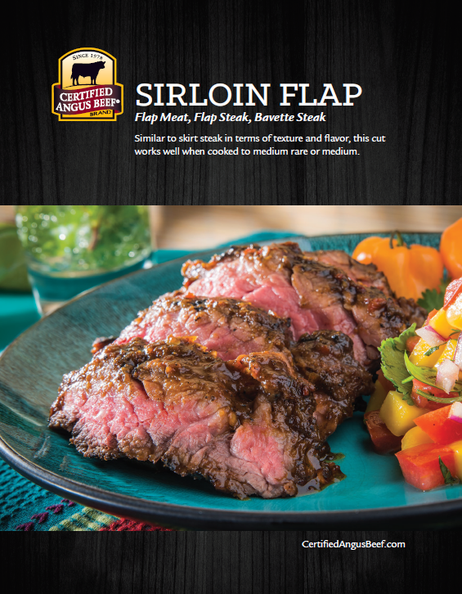
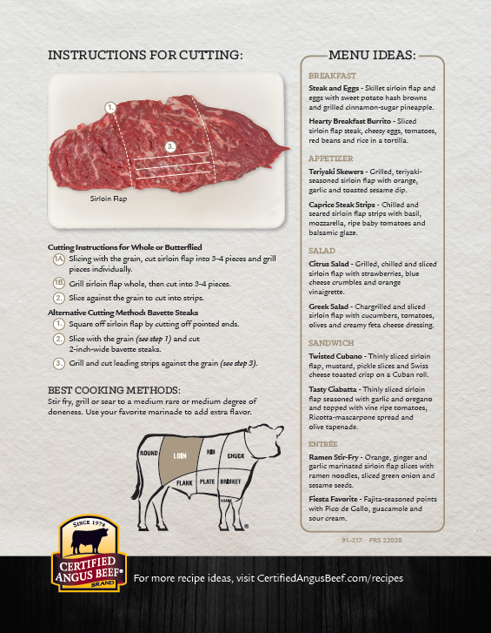

Slide 3
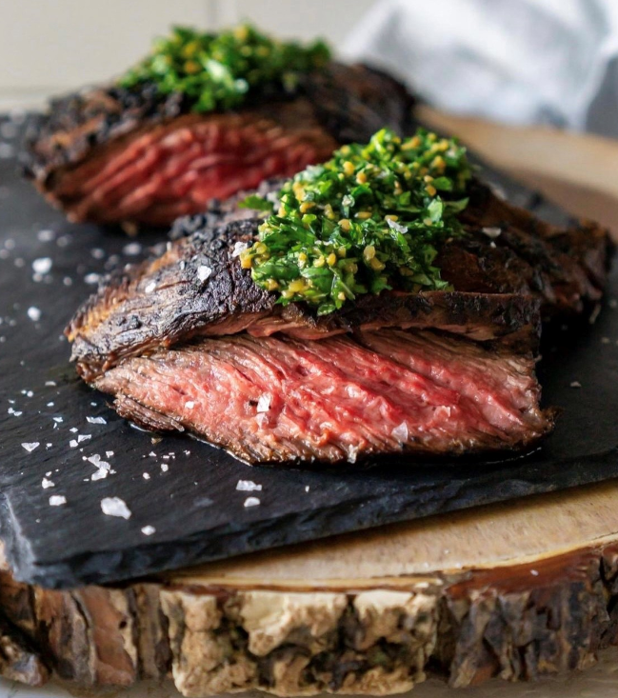
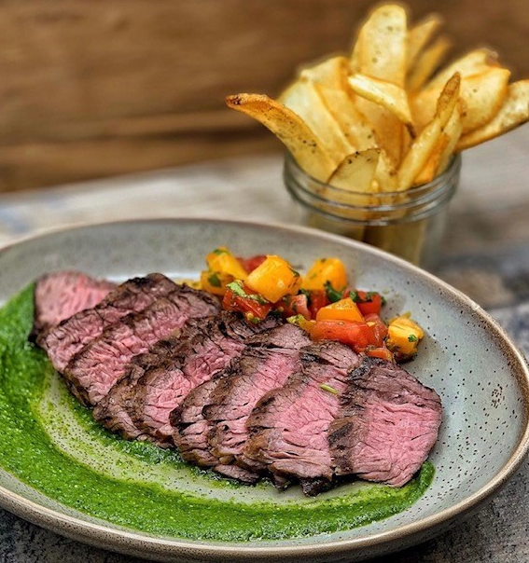
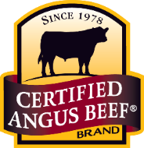
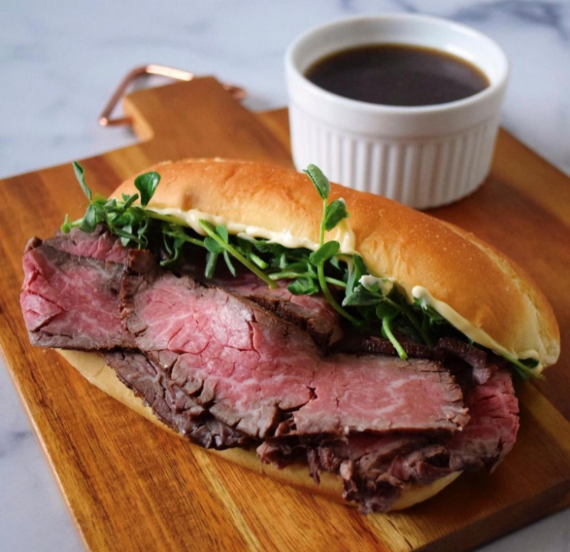
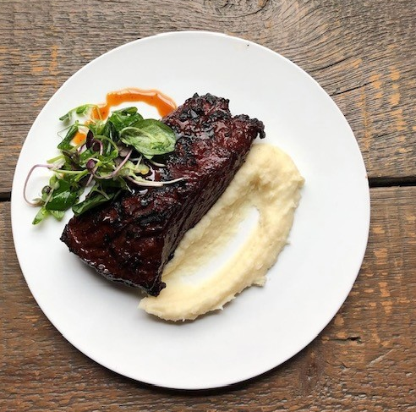
Sirloin Flap
Cooking Methods:
Best grilled over high heat and cooked
to a medium doneness.
Suggested technique/serving:
Crucial to acknowledge proper slicing
technique to be against the grain.
Bavette steaks are great for center-of-the-plate featured cuts. To serve, slice a few leading slices into the steak, so guests know how to cut it properly.
Flavor Profile:
Takes on sugar-based marinades very well and chars beautifully on the grill.

Slide 4
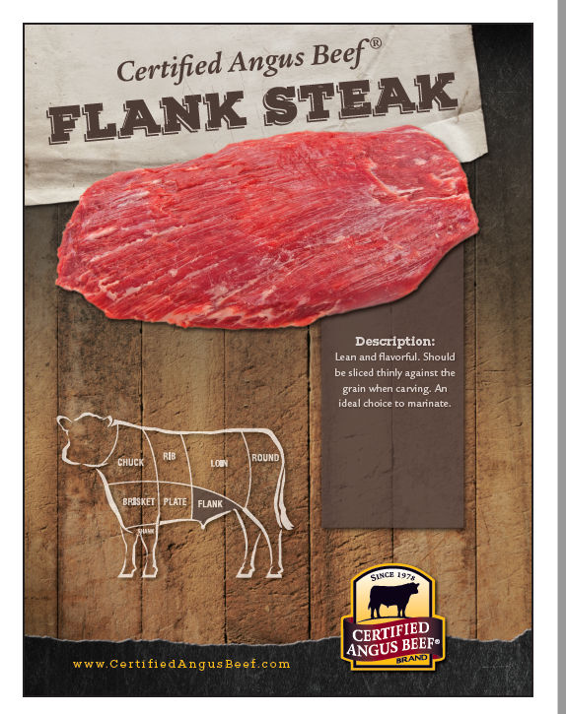
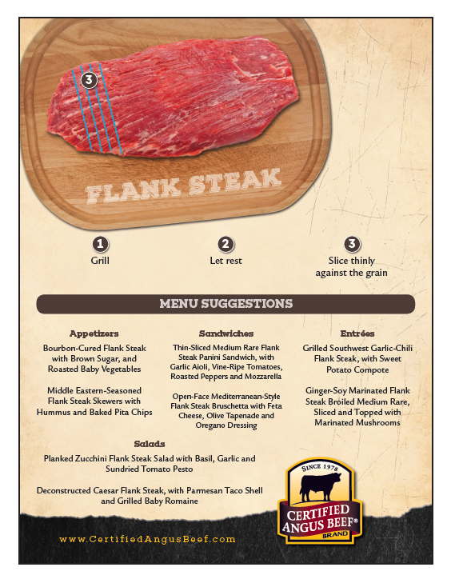

Slide 5
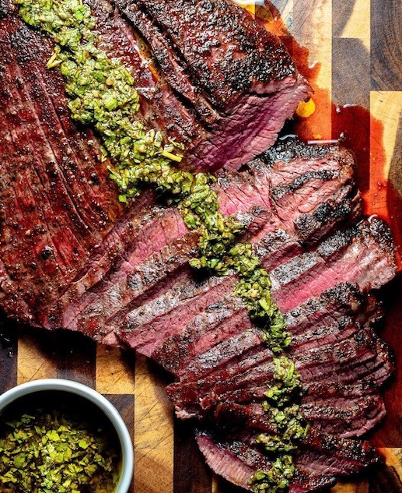
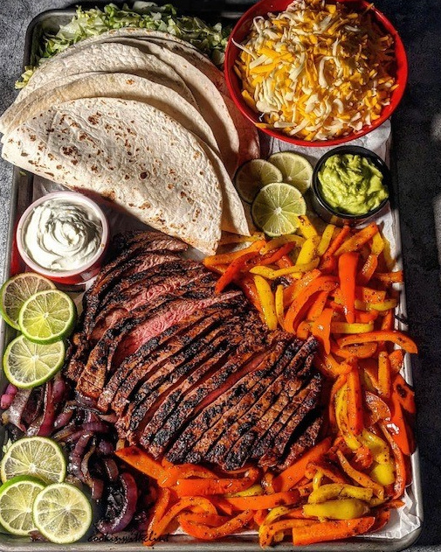
Flank Steak
Cooking Methods:
Fantastic grilled over high heat or pan seared.
Suggested Degree of Doneness:
Medium rare/Medium
Flavor Profile:
Takes on citrus marinades well and
makes phenomenal fajitas.

Slide 6
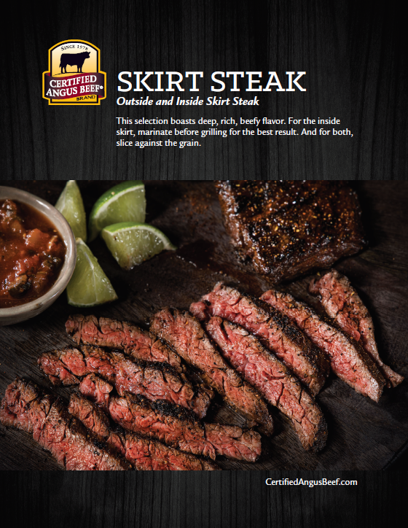
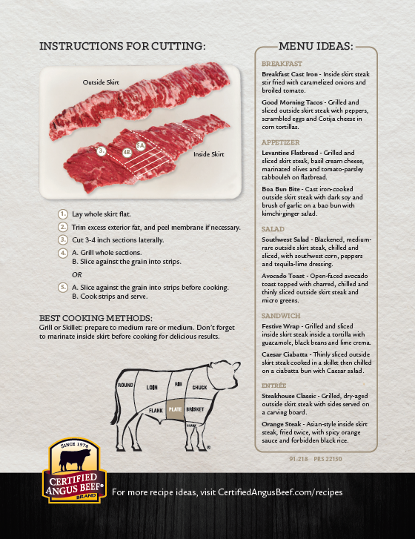

Slide 7
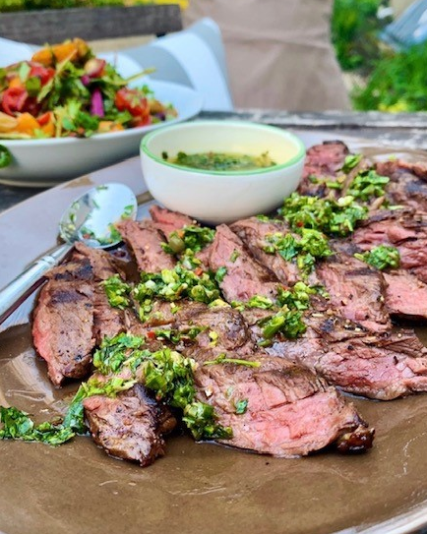
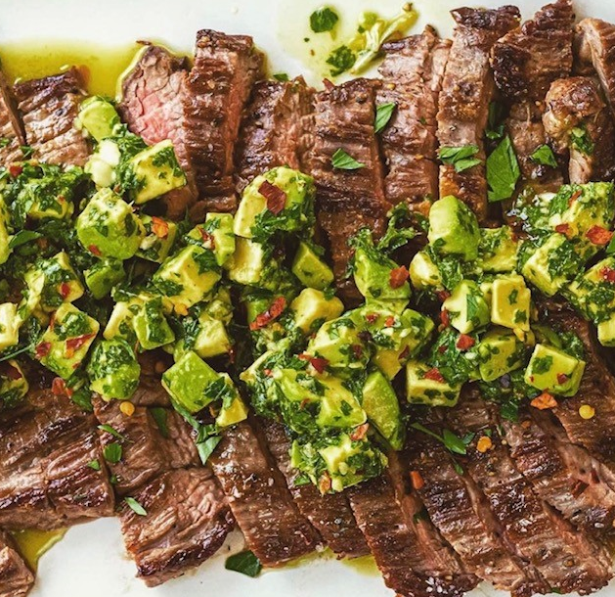
Outside
Skirt
Cooking Methods:
Quick cooking over high-heat grill.
Suggested Degree of Doneness:
Medium
Flavor Profile:
Takes on any dry rub or marinade very
well and makes for the best tacos!
*Higher in demand due to its robust flavor
Great option for sliced menu applications

Slide 8
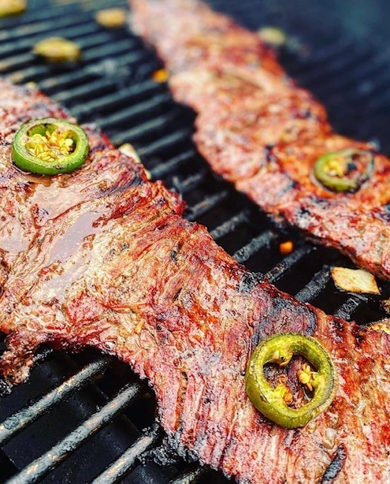
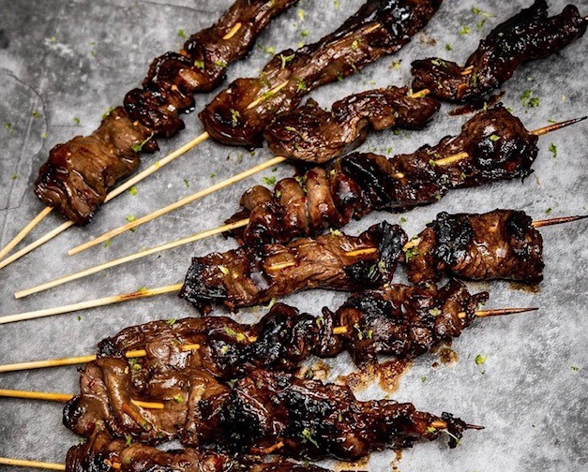
Inside
Skirt
Cooking Methods:
Quick cooking over high-heat grill.
Suggested Degree of Doneness:
Medium
Flavor Profile:
Takes on any dry rub or marinade very
well and makes for the best tacos!
*Perfect option for tacos or stir fry
Ideal for multiple menu options at a reasonable price

Slide 9
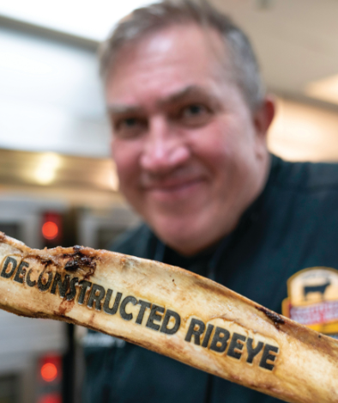
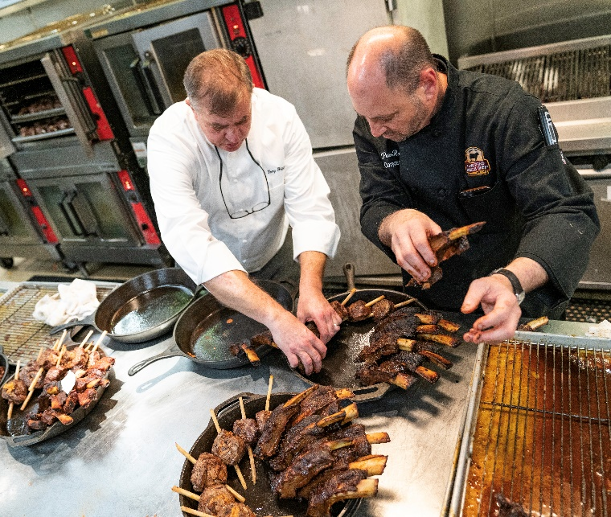
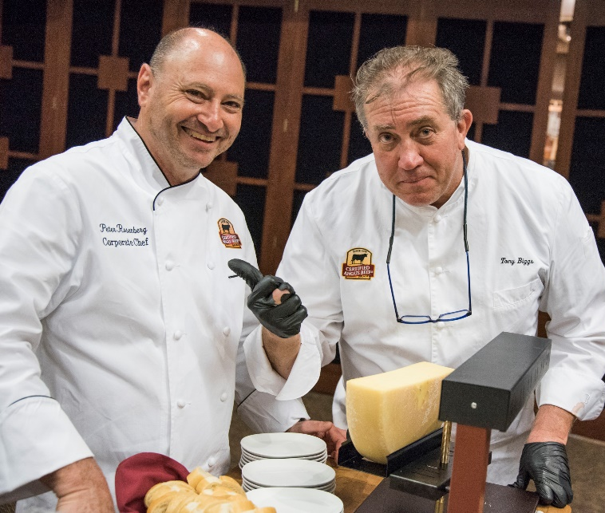
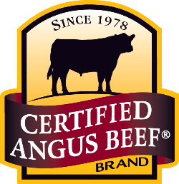
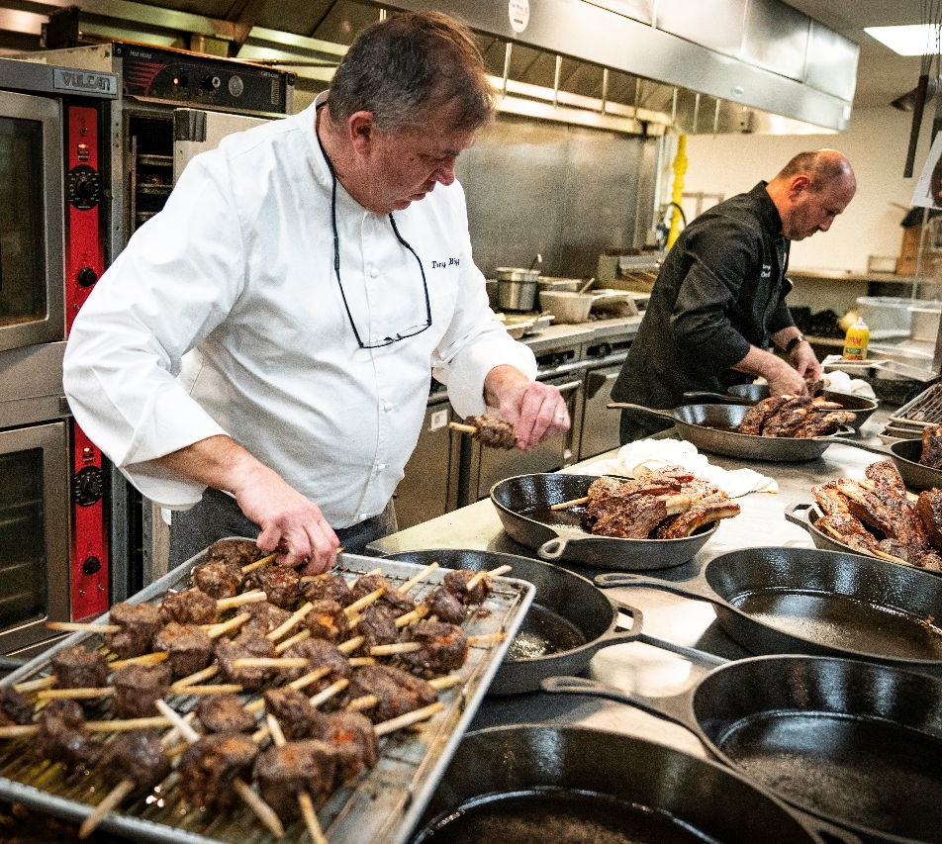
Personalized
Cut Ideation
Available
Contact us for
more information. cs@certifiedangusbeef.com
Notes:
Too corporate looking

